Slide 1

Introduction to Convolutional Neural Networks
A convolutional neural network (CNN) is a type of artificial intelligence (AI) algorithm that is most commonly used for analyzing visual imagery. It is inspired by the organization and functionality of the visual cortex in the human brain and is highly efficient for image recognition and classification tasks.

Slide 2
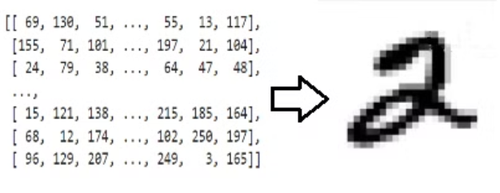

The Architecture of a CNN

Slide 3
Convolutional Layers and Their Purpose
1
Feature Extraction
2
Parameter Sharing
3
Spacial Hierarchies
Convolutional layers are responsible for extracting features from input images through the use of learnable filters that slide across the input and detect patterns and structures.
By using shared weights, convolutional layers reduce the number of parameters, making it possible to apply the same feature detector across the entire input, improving efficiency.
These layers help in creating a hierarchical representation of the input data, capturing high-level features by combining low-level features, enabling deeper insights into the data.

Slide 4

Convolution layer

Slide 5

Convolution for 1D array

Slide 6

Convolution for 3D array(RGB image)

Slide 7

Padding and stride
with padding = 1 and stride = 2

Slide 8
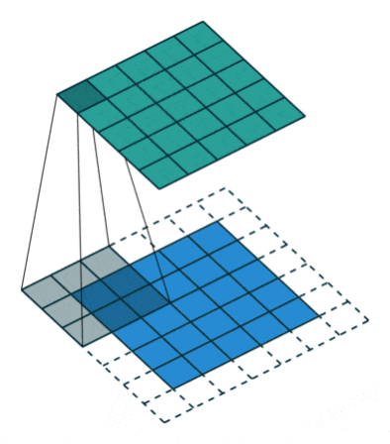
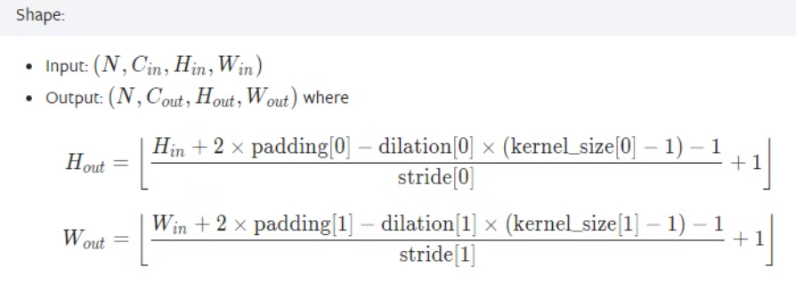
Padding and Stride
with padding = 1 and stride = 1
nn.Conv2d(in_channels=16, out_channels=33, kernerl=(3,3), stride=2, padding= 1)

Slide 9
Filters/kernels in CNN
3x3
5x5
7x7
Size
Diversity
Specialization
The most common filter size used in CNNs is 3x3, which captures local dependencies within the input, aiding in feature extraction.
Filters come in various sizes, such as 5x5, providing diversity in feature extraction, allowing for the detection of more complex patterns in the data.
7x7 filters are used to capture larger patterns within the input, specializing in recognizing more global features and structures.

Slide 10
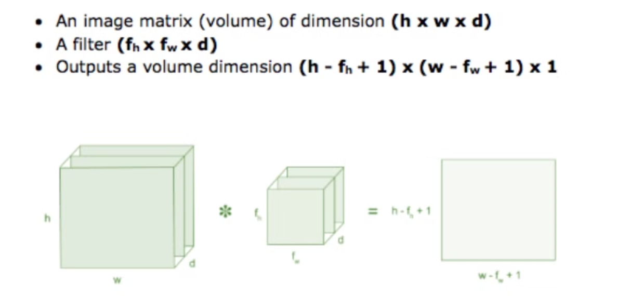
Feature map is the output of the convolution operation, and its dimension can be calculated with this operation

Slide 11

Applying convolution with different kernels

Slide 12
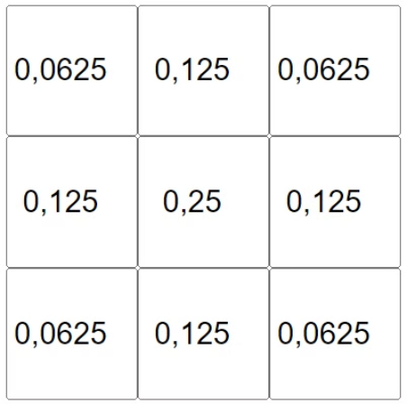
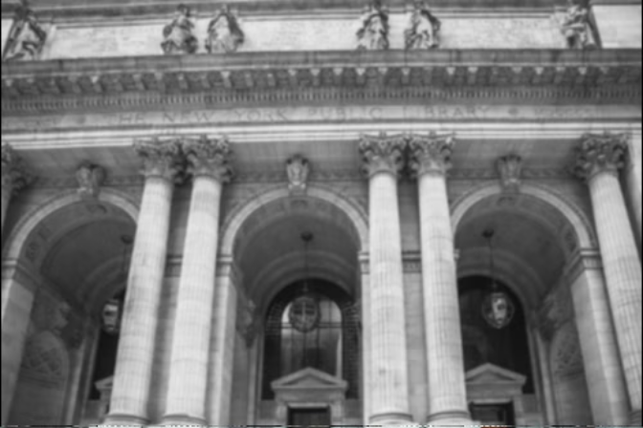
blur kernel

Slide 13
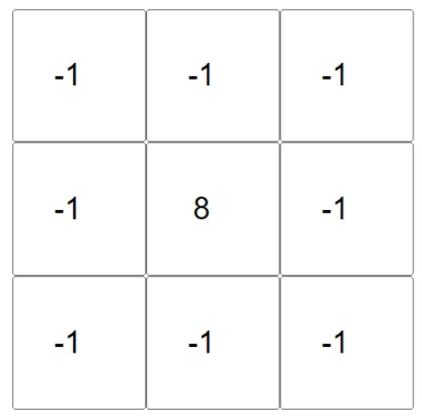
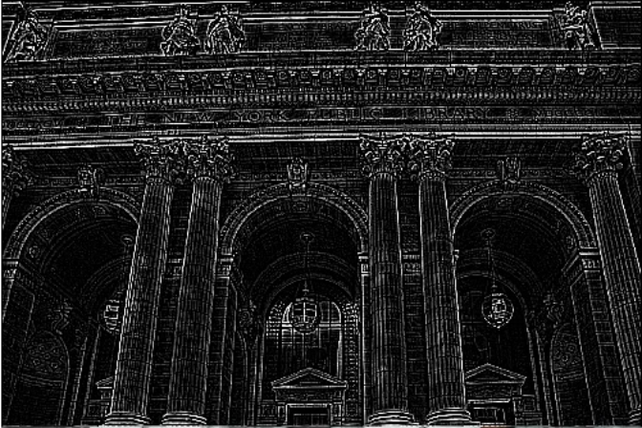
Outline kernel

Slide 14
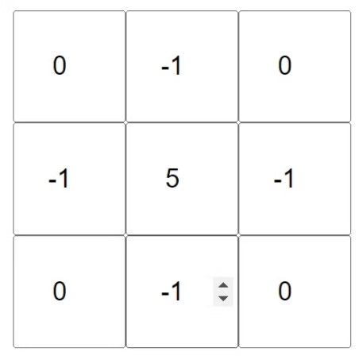
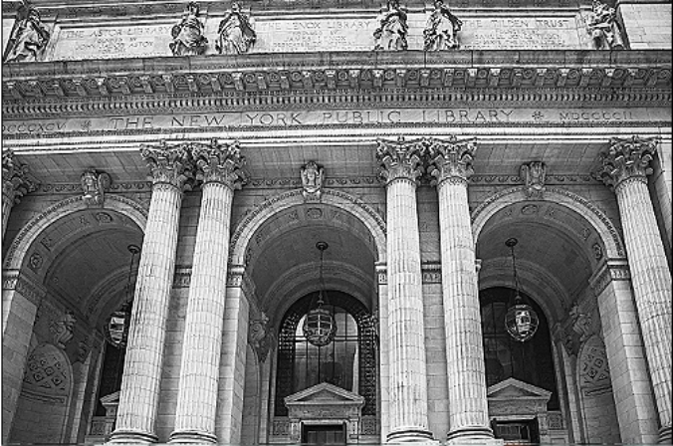
Sharpen kernel

Slide 15
Pooling
Pooling layers reduce the spatial dimensions of the input, which helps in decreasing the computational load and maintaining the main features.

Slide 16
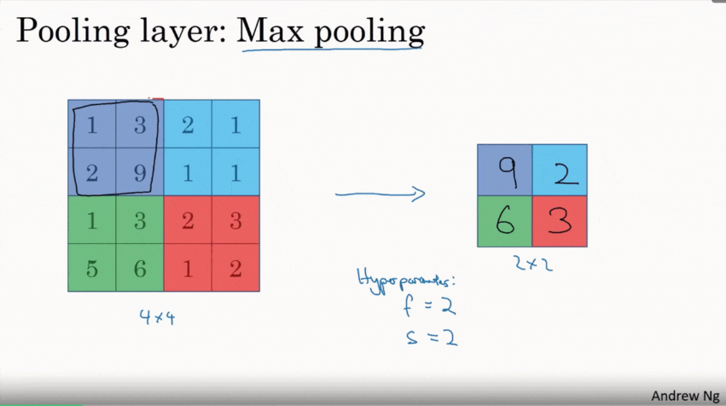
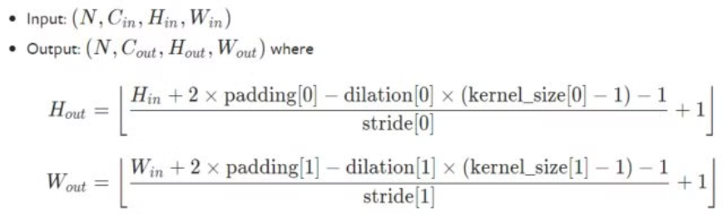
Max pooling
nn.MaxPool2d(2, stride=2)

Slide 17
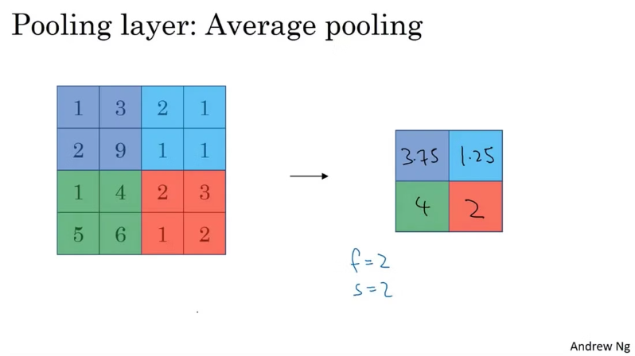
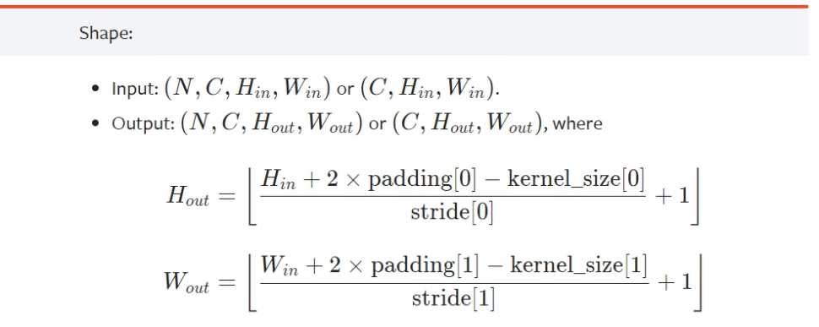
Average pooling
nn.AvgPool2d(2, stride=2)

Slide 18
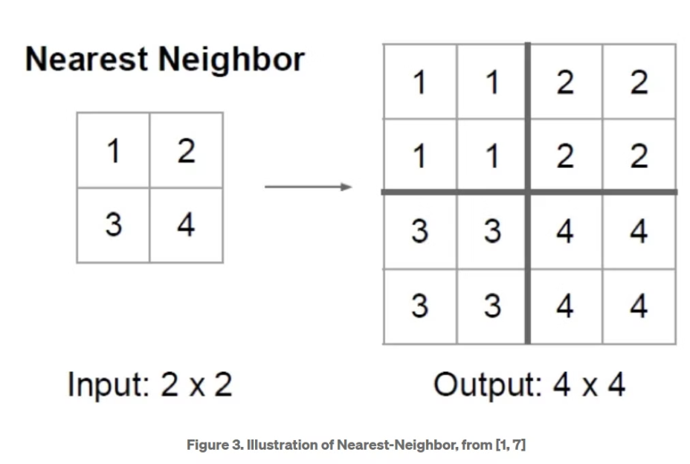
Unpooling layer
Nearest neighbor

Slide 19
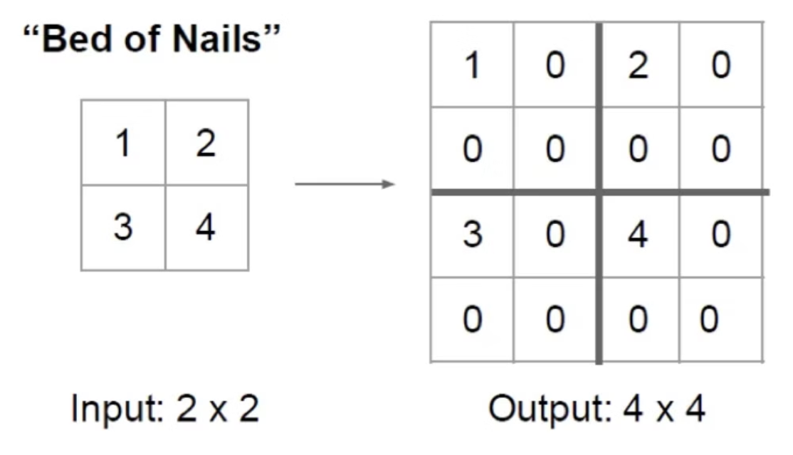
Bed of nails

Slide 20
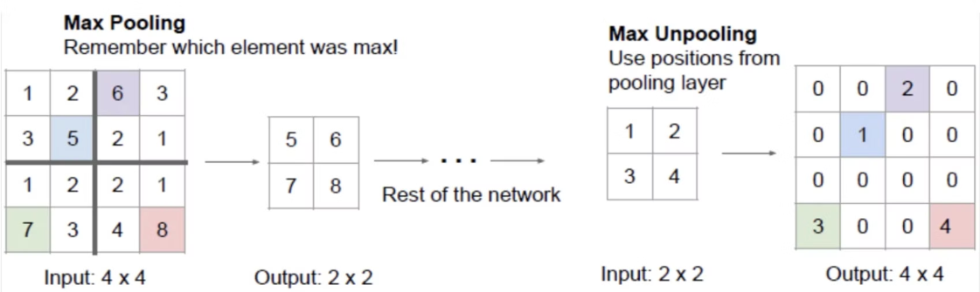
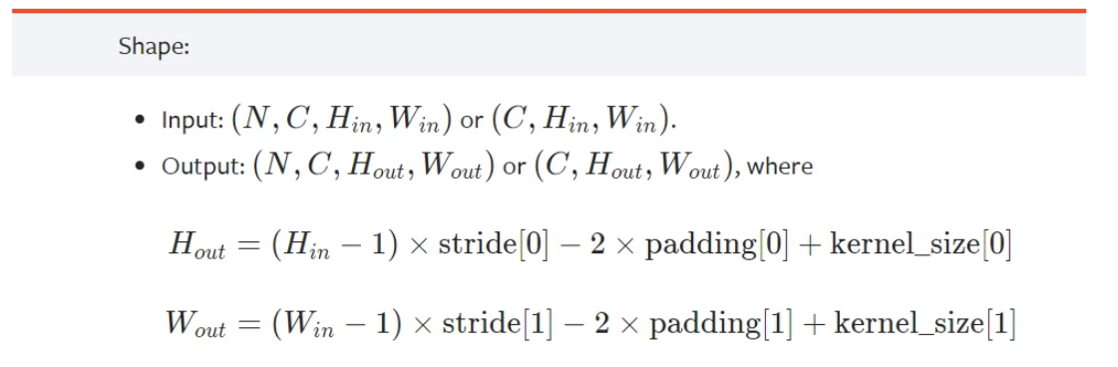
Max unpooling
nn.MaxUnpool2d(2, stride=2)

Slide 21
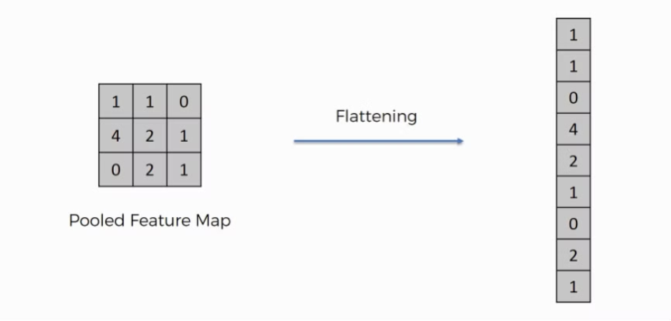
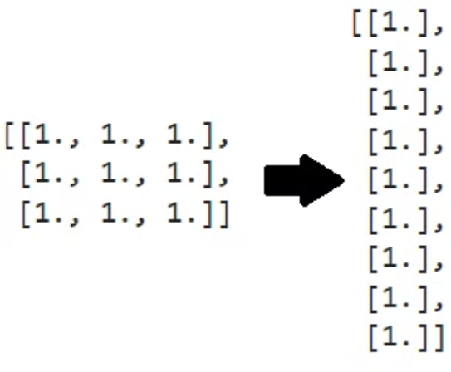
Flatten
torch.flatten(CNN)

Slide 22
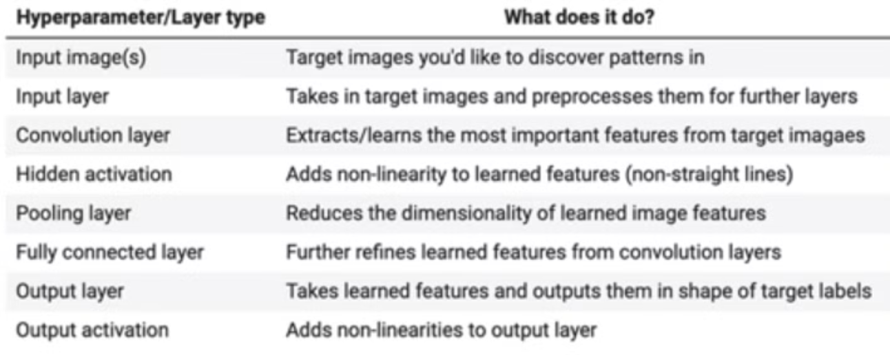

Slide 23
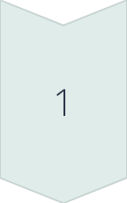
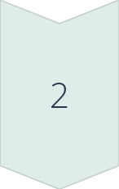
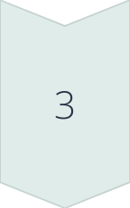
Activation Functions Used in CNNs
Rectified Linear Unit (ReLU)
One of the most commonly used activation functions, ReLU effectively mitigates the vanishing gradient problem and speeds up training.
Sigmoid
Although less commonly used in CNNs, the sigmoid function is used in binary classification tasks as it squashes input to a range of 0 to 1.
Tanh
Tanh is another activation function that maps input to a range of -1 to 1, allowing for better training in deeper networks.

Slide 24
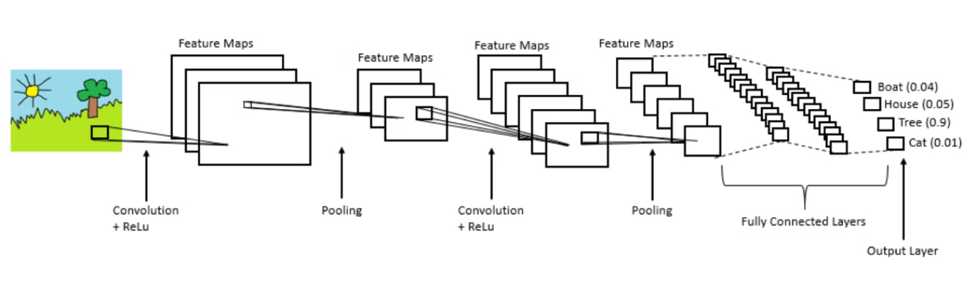
Example convolutional neural network

Slide 25
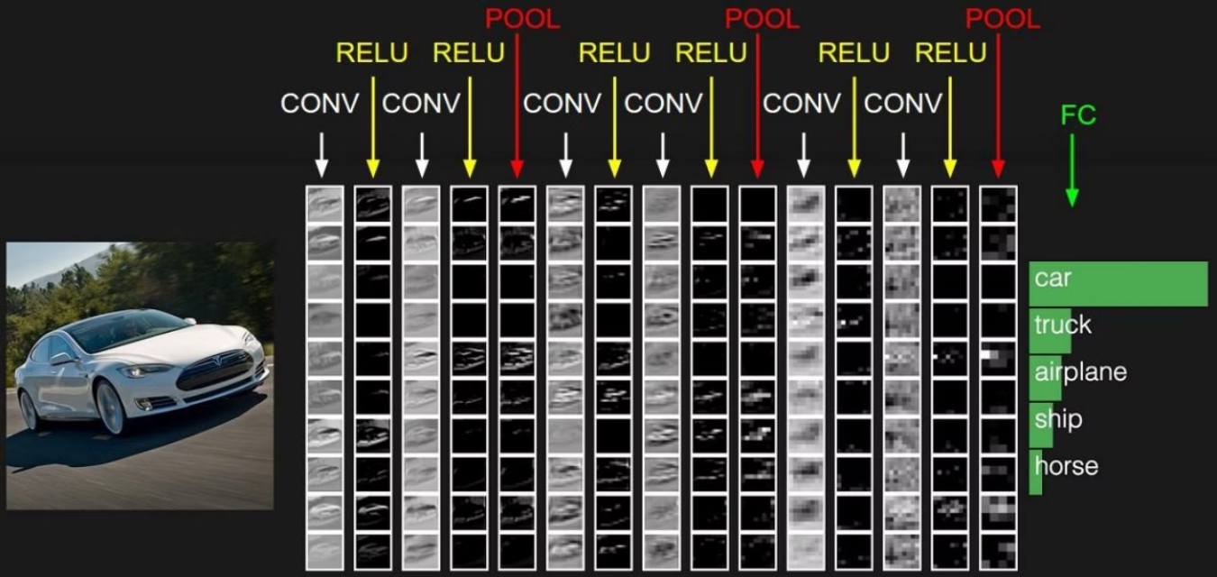
Example convolutional neural network

Slide 26
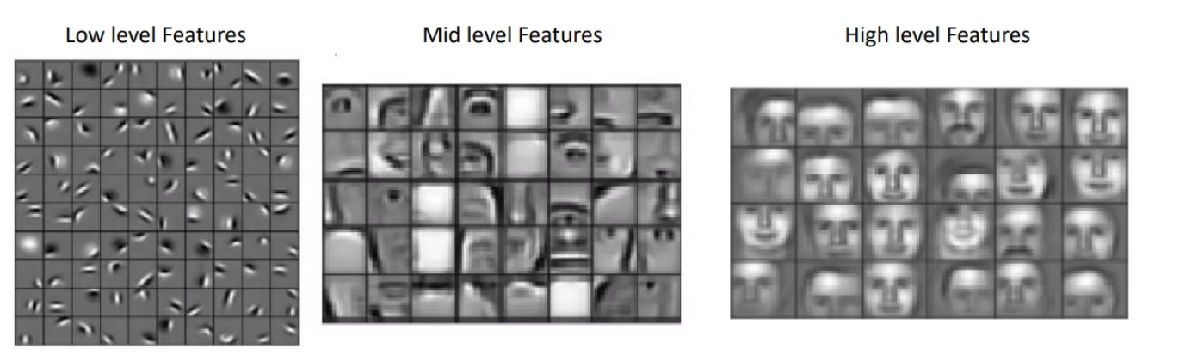
The features get more complex as we go deep in the network

Slide 27
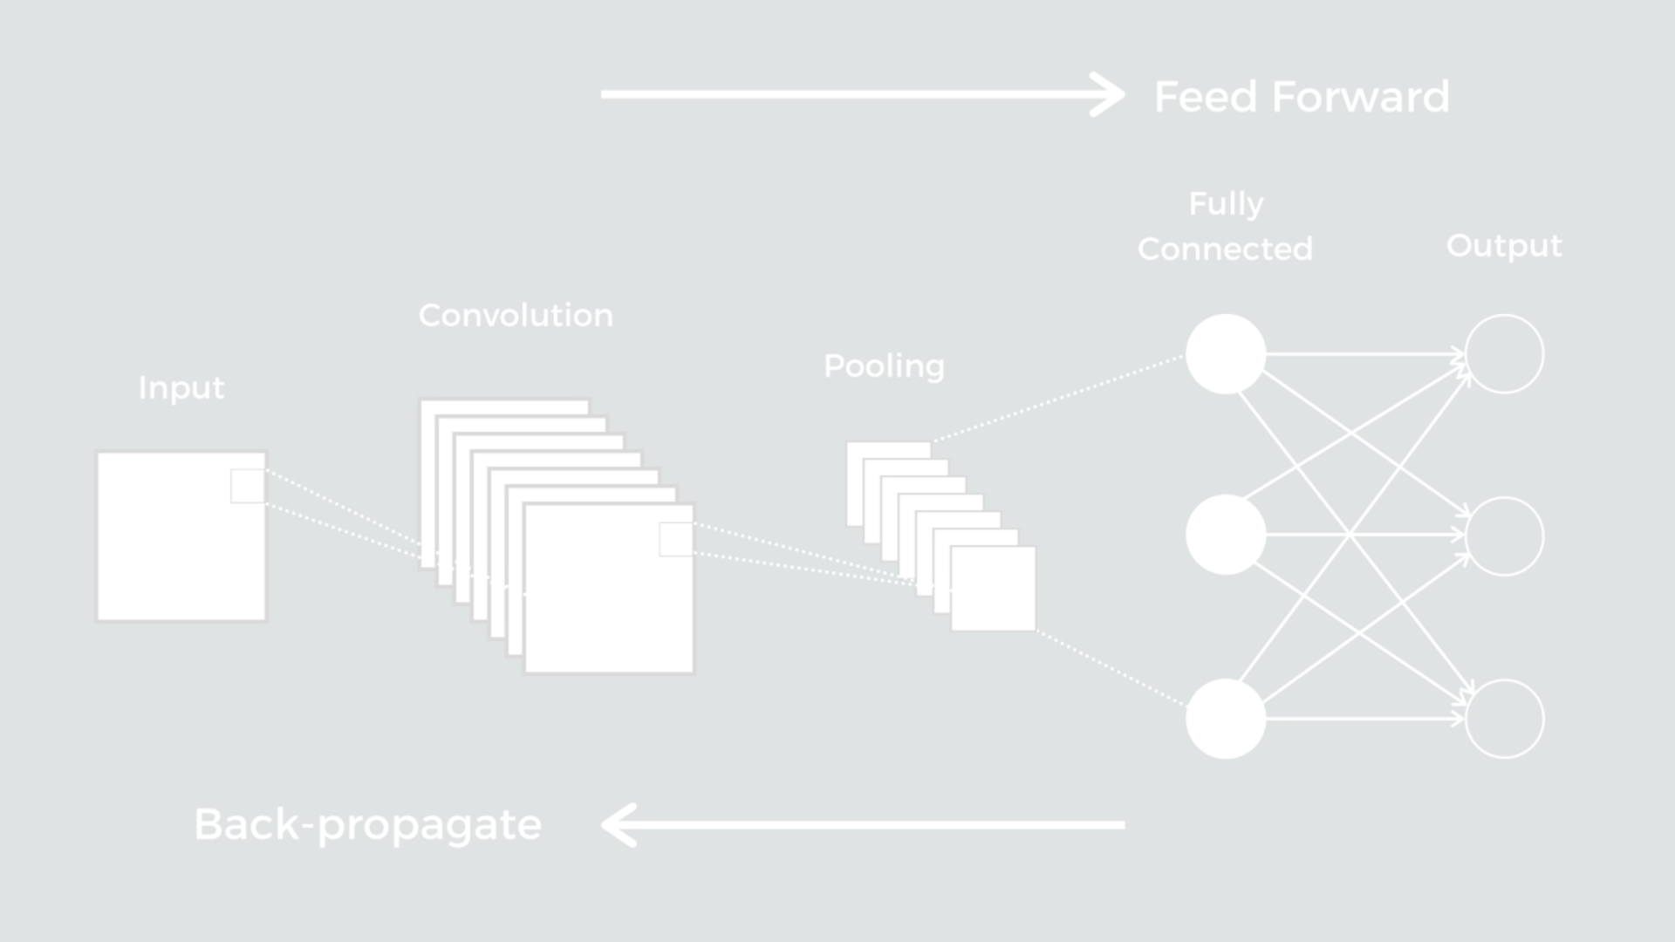
Training a CNN
Data Preprocessing
1
Training data is preprocessed to standardize, normalize, and augment it to ensure the network trains on high-quality data.
2
Optimization Techniques
Various optimization techniques such as gradient descent, learning rate schedules, and momentum are applied to improve the training process.
Model Evaluation
3
Trained models need to be rigorously evaluated using metrics like accuracy, precision, recall, and F1 score to ensure their effectiveness.

Slide 28
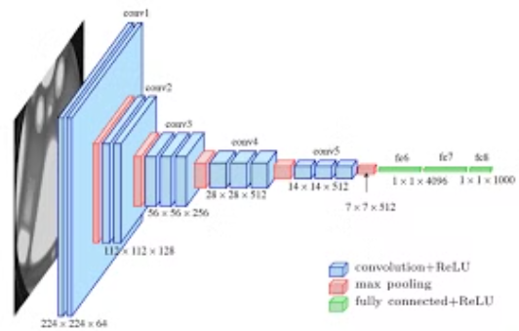
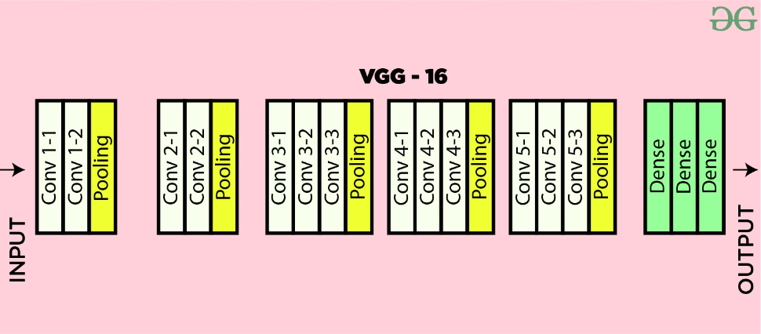
Some CNN algorithms
Classification : VGG16

Slide 29
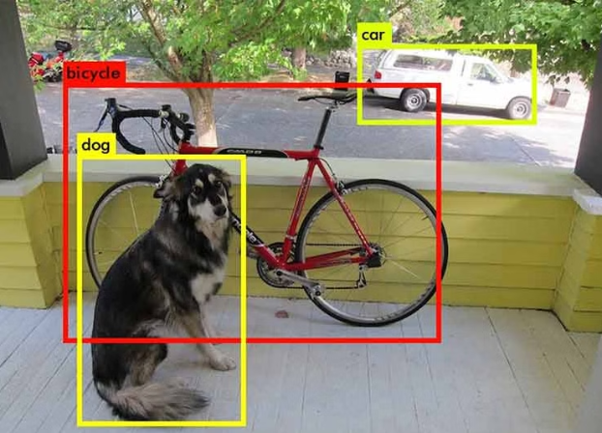
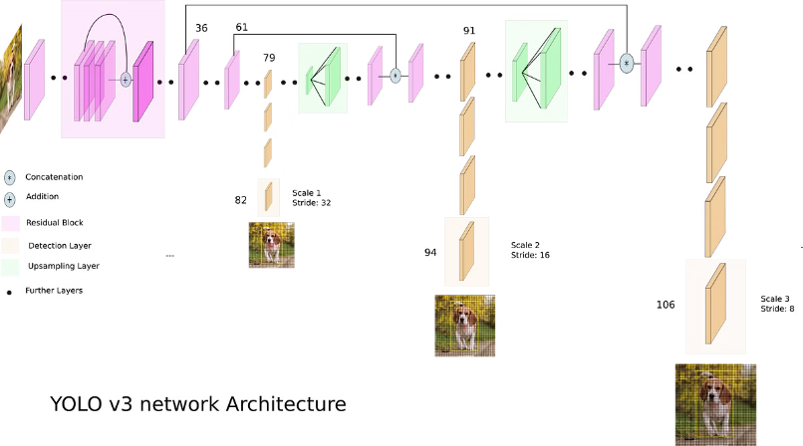
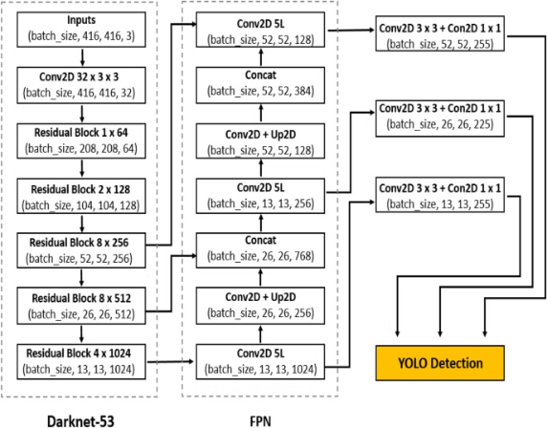
Object Detection :
Yolov3 :

Slide 30
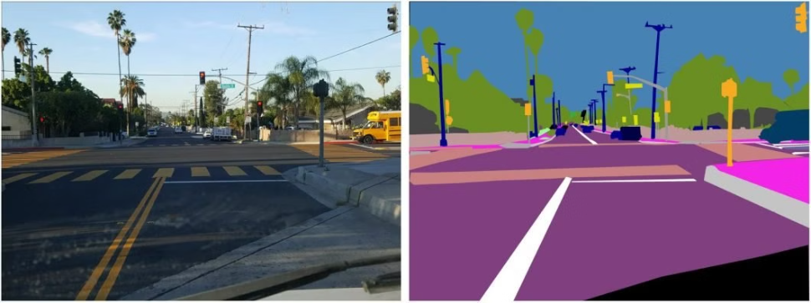
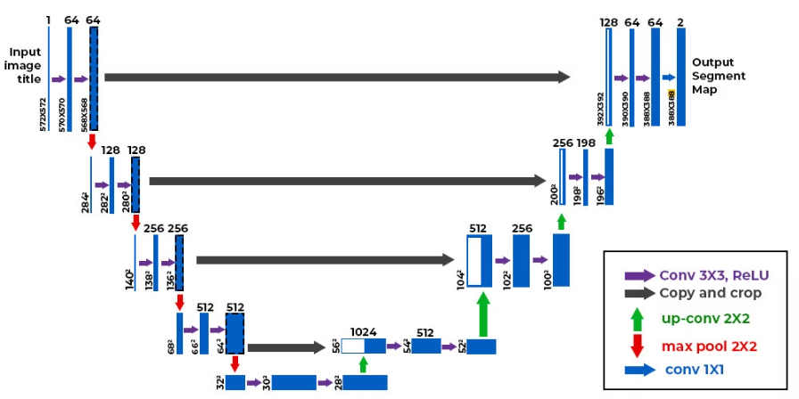
Segmentation
Unet

